Slide 1


Module 3: Backend – advanced Workflow Execution
Developing Business Applications with

Slide 2




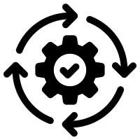



Browser
Module 3: Backend – advanced (jobs & workflows)
Client
WebSocket
Application Services
HTTP
HTTP
Authorization
Server
Web
Server
Job
Orchestrator
Job
Host(s)
Job
Host(s)
HTTP
Job
Host(s)
HTTP
TCP/IP
TCP/IP
HTTP
HTTP
Infrastructure Services
Azure
PostgreSQL
MIKE Cloud
Services

Slide 3

Purpose of the Workflow - History
Architecture
Workflow Example
Building blocks – Actions
Scenarios
Notes:
<use this slide for agenda>

Slide 4
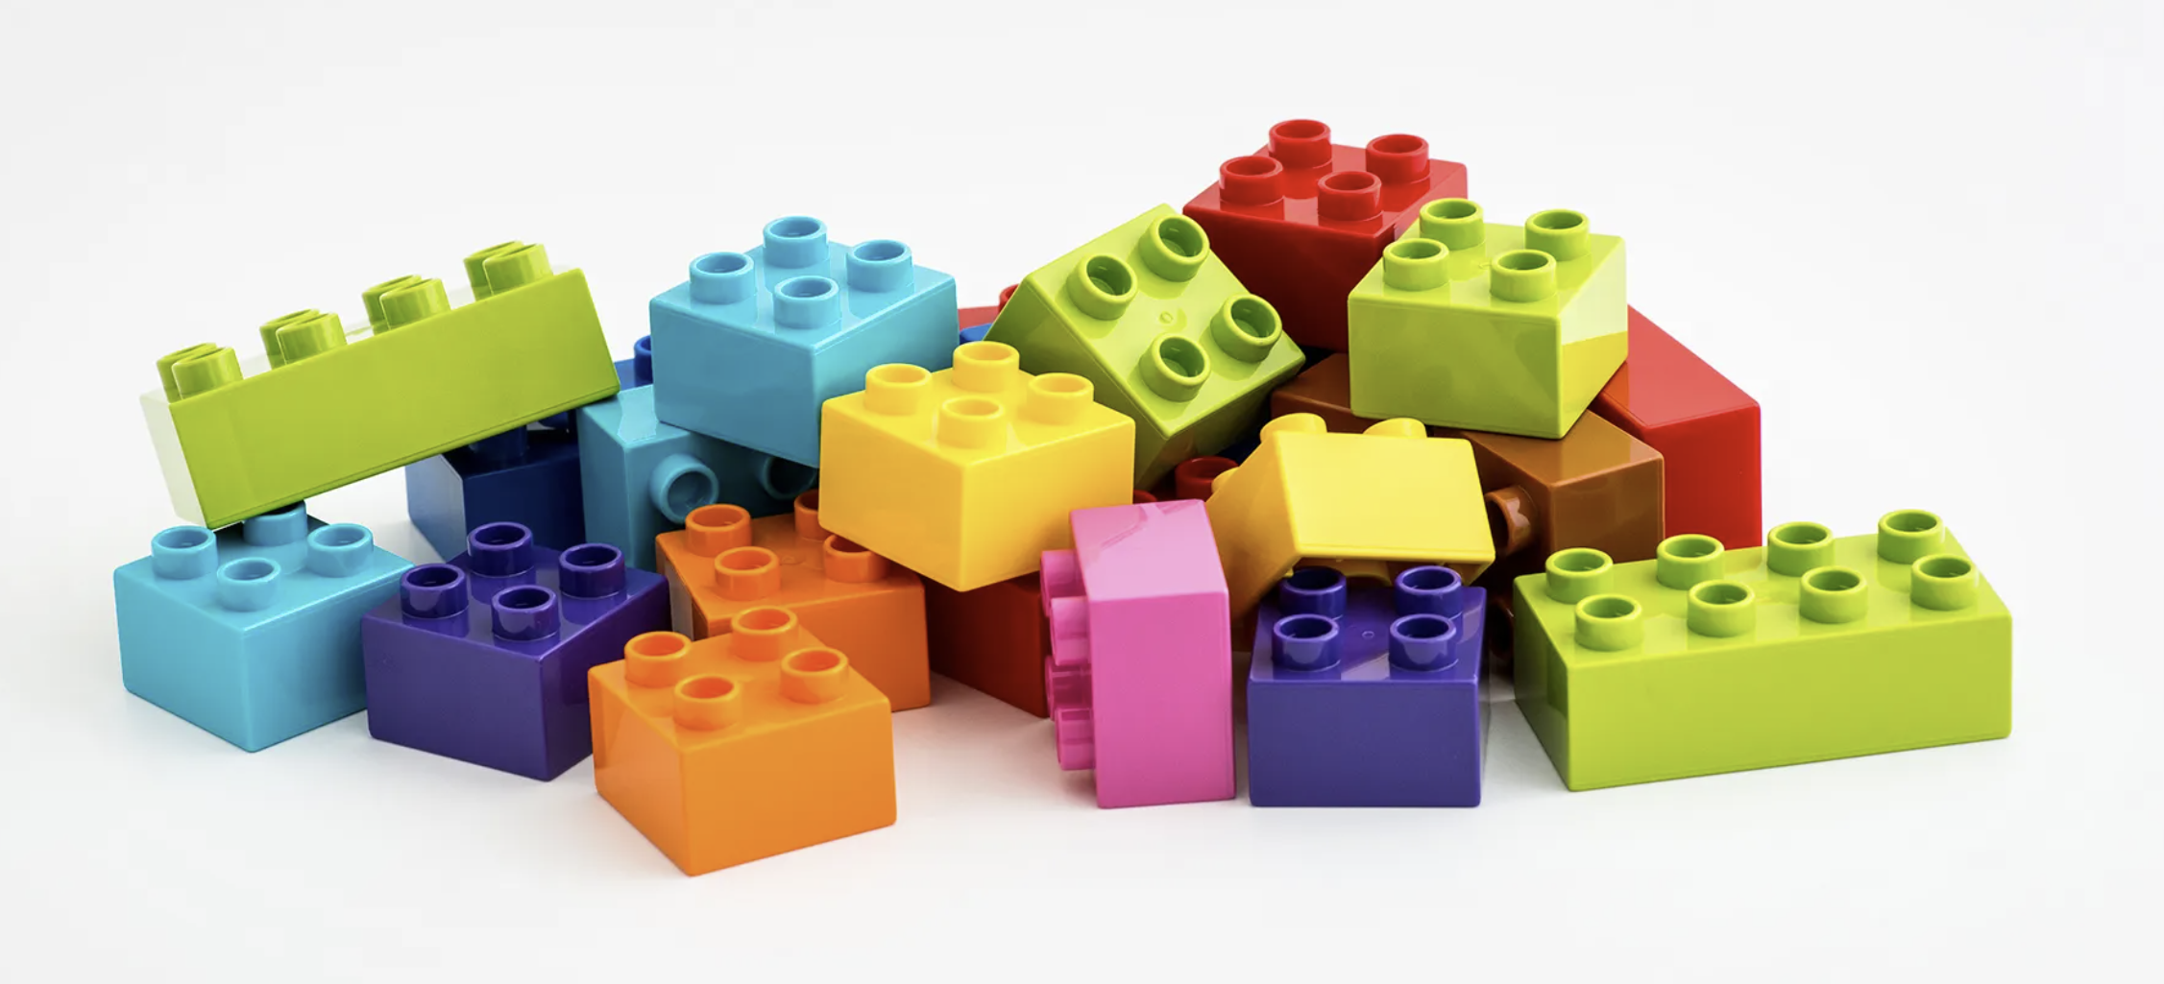
Who Am I
Franz Thomsen - Head of Port IT / Cybersecurity, Seaport OPX
With DHI since 2001 - first operational systems in 2003
Lots of front-ends through multiple tech stacks
Lots of backends through multiple tech stacks, supporting frontend
Backend “async” scenario/workflow systems since 2009
Reusable, Reusable, REUSABLE
Notes:
<use this slide for agenda>

Slide 5
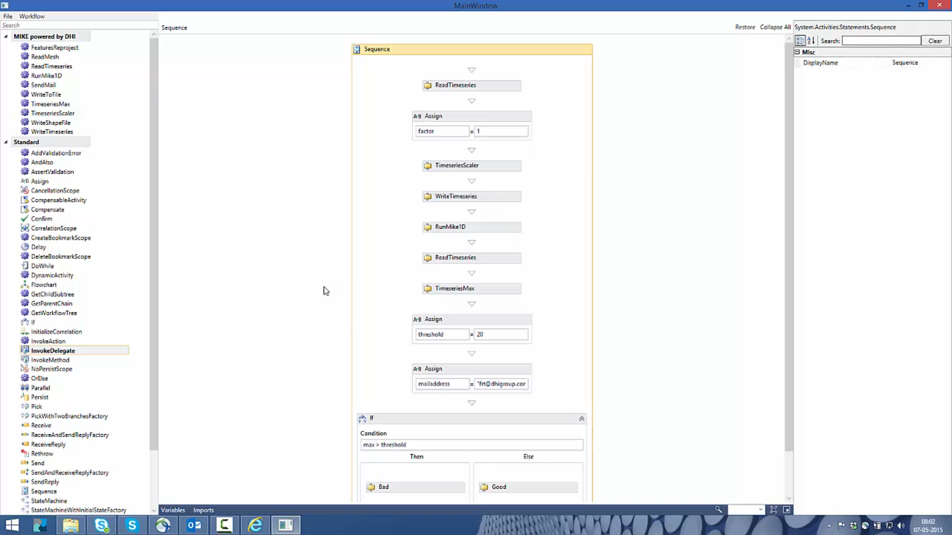
History – 2015 Windows Workflow Foundation is amazing
Reusable building blocks that snaps together through Code Activities
Designer through Windows Workflow Foundation
Xaml based workflows
Domain Services as pillar
Notes:
<use this slide for agenda>

Slide 6
History – 2021 Windows Workflow Foundation is going out, no .net core support
Reusable building blocks that snaps together through Actions (code from Code Activities moved to Actions)
No designer, Visual Studio is used
C# based workflows
(This is where we are now)
Notes:
<use this slide for agenda>

Slide 7
Beyond A designer just makes things very accessible for everyone – ELSA?
Reusable building blocks that snaps together through ELSA Activities wrapping Actions
Web based designer
Json based workflows
Notes:
<use this slide for agenda>

Slide 8
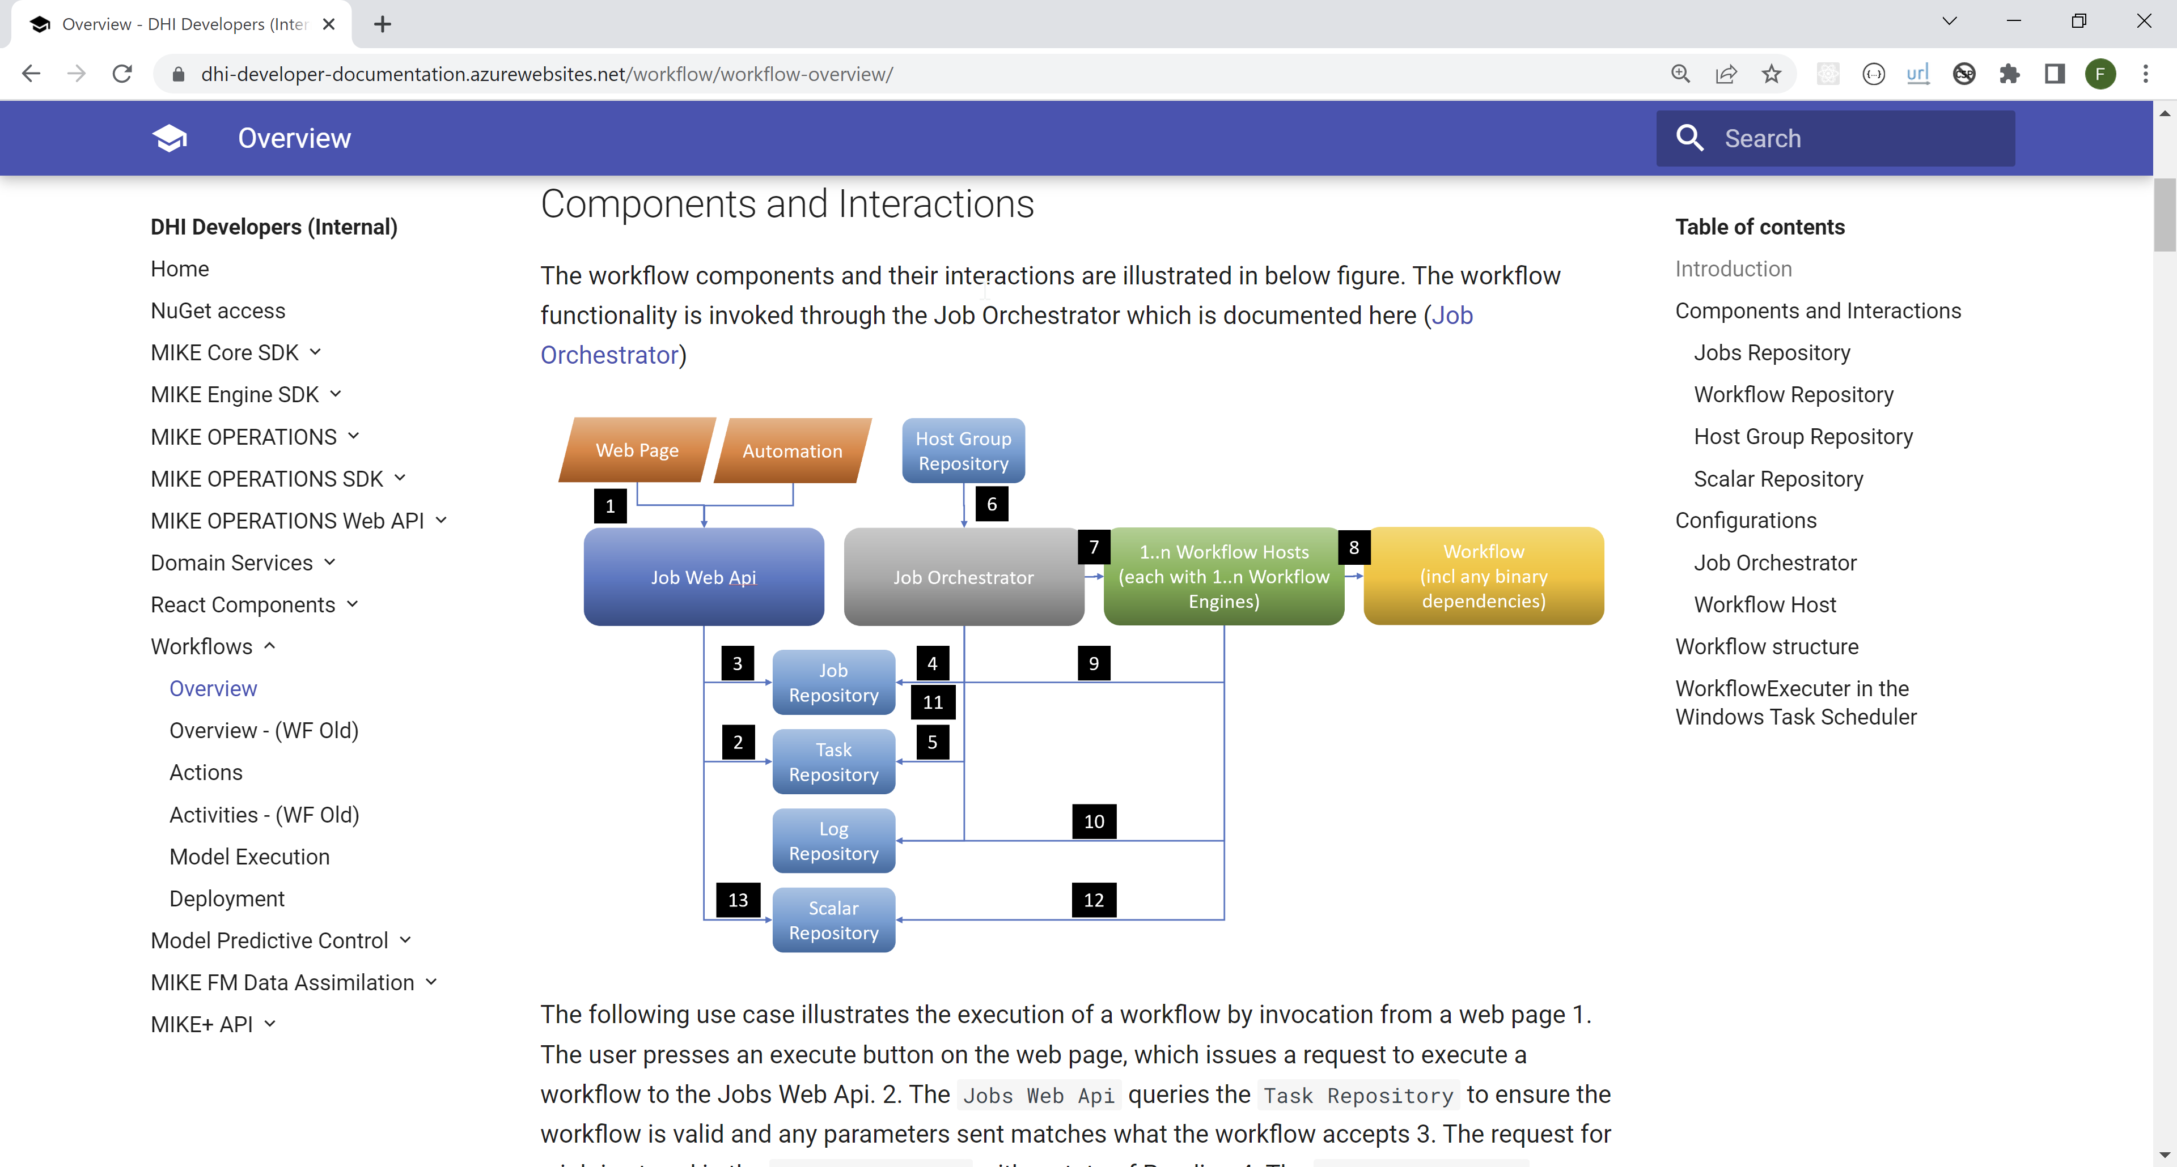
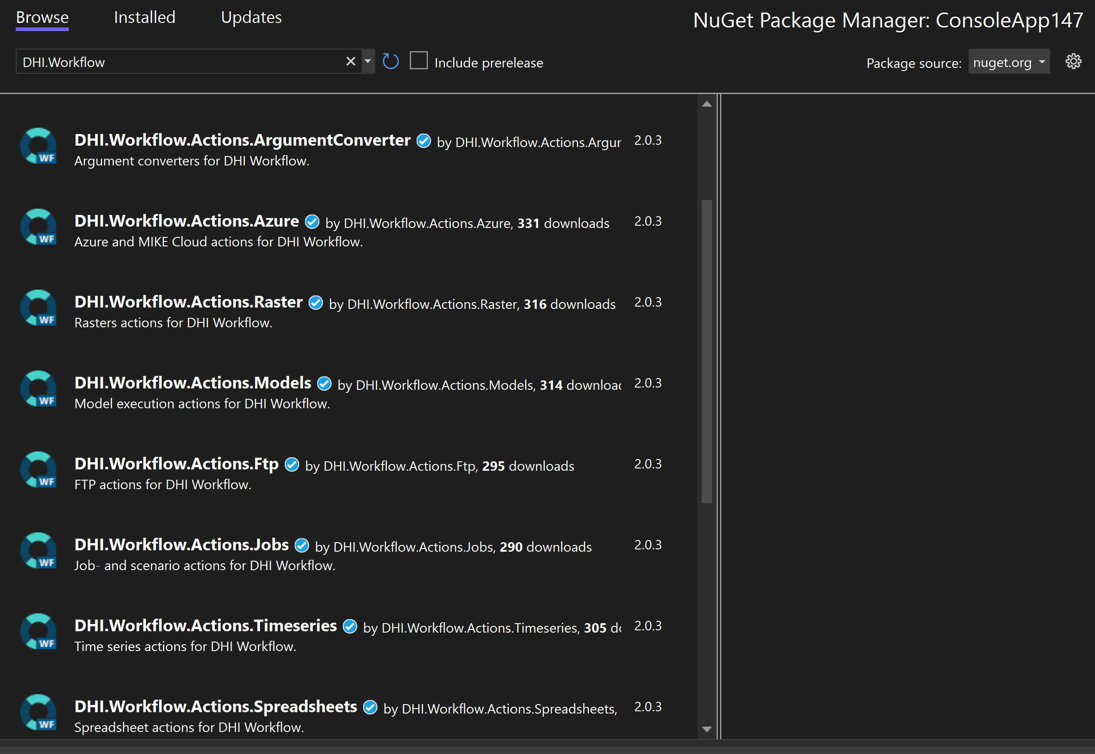
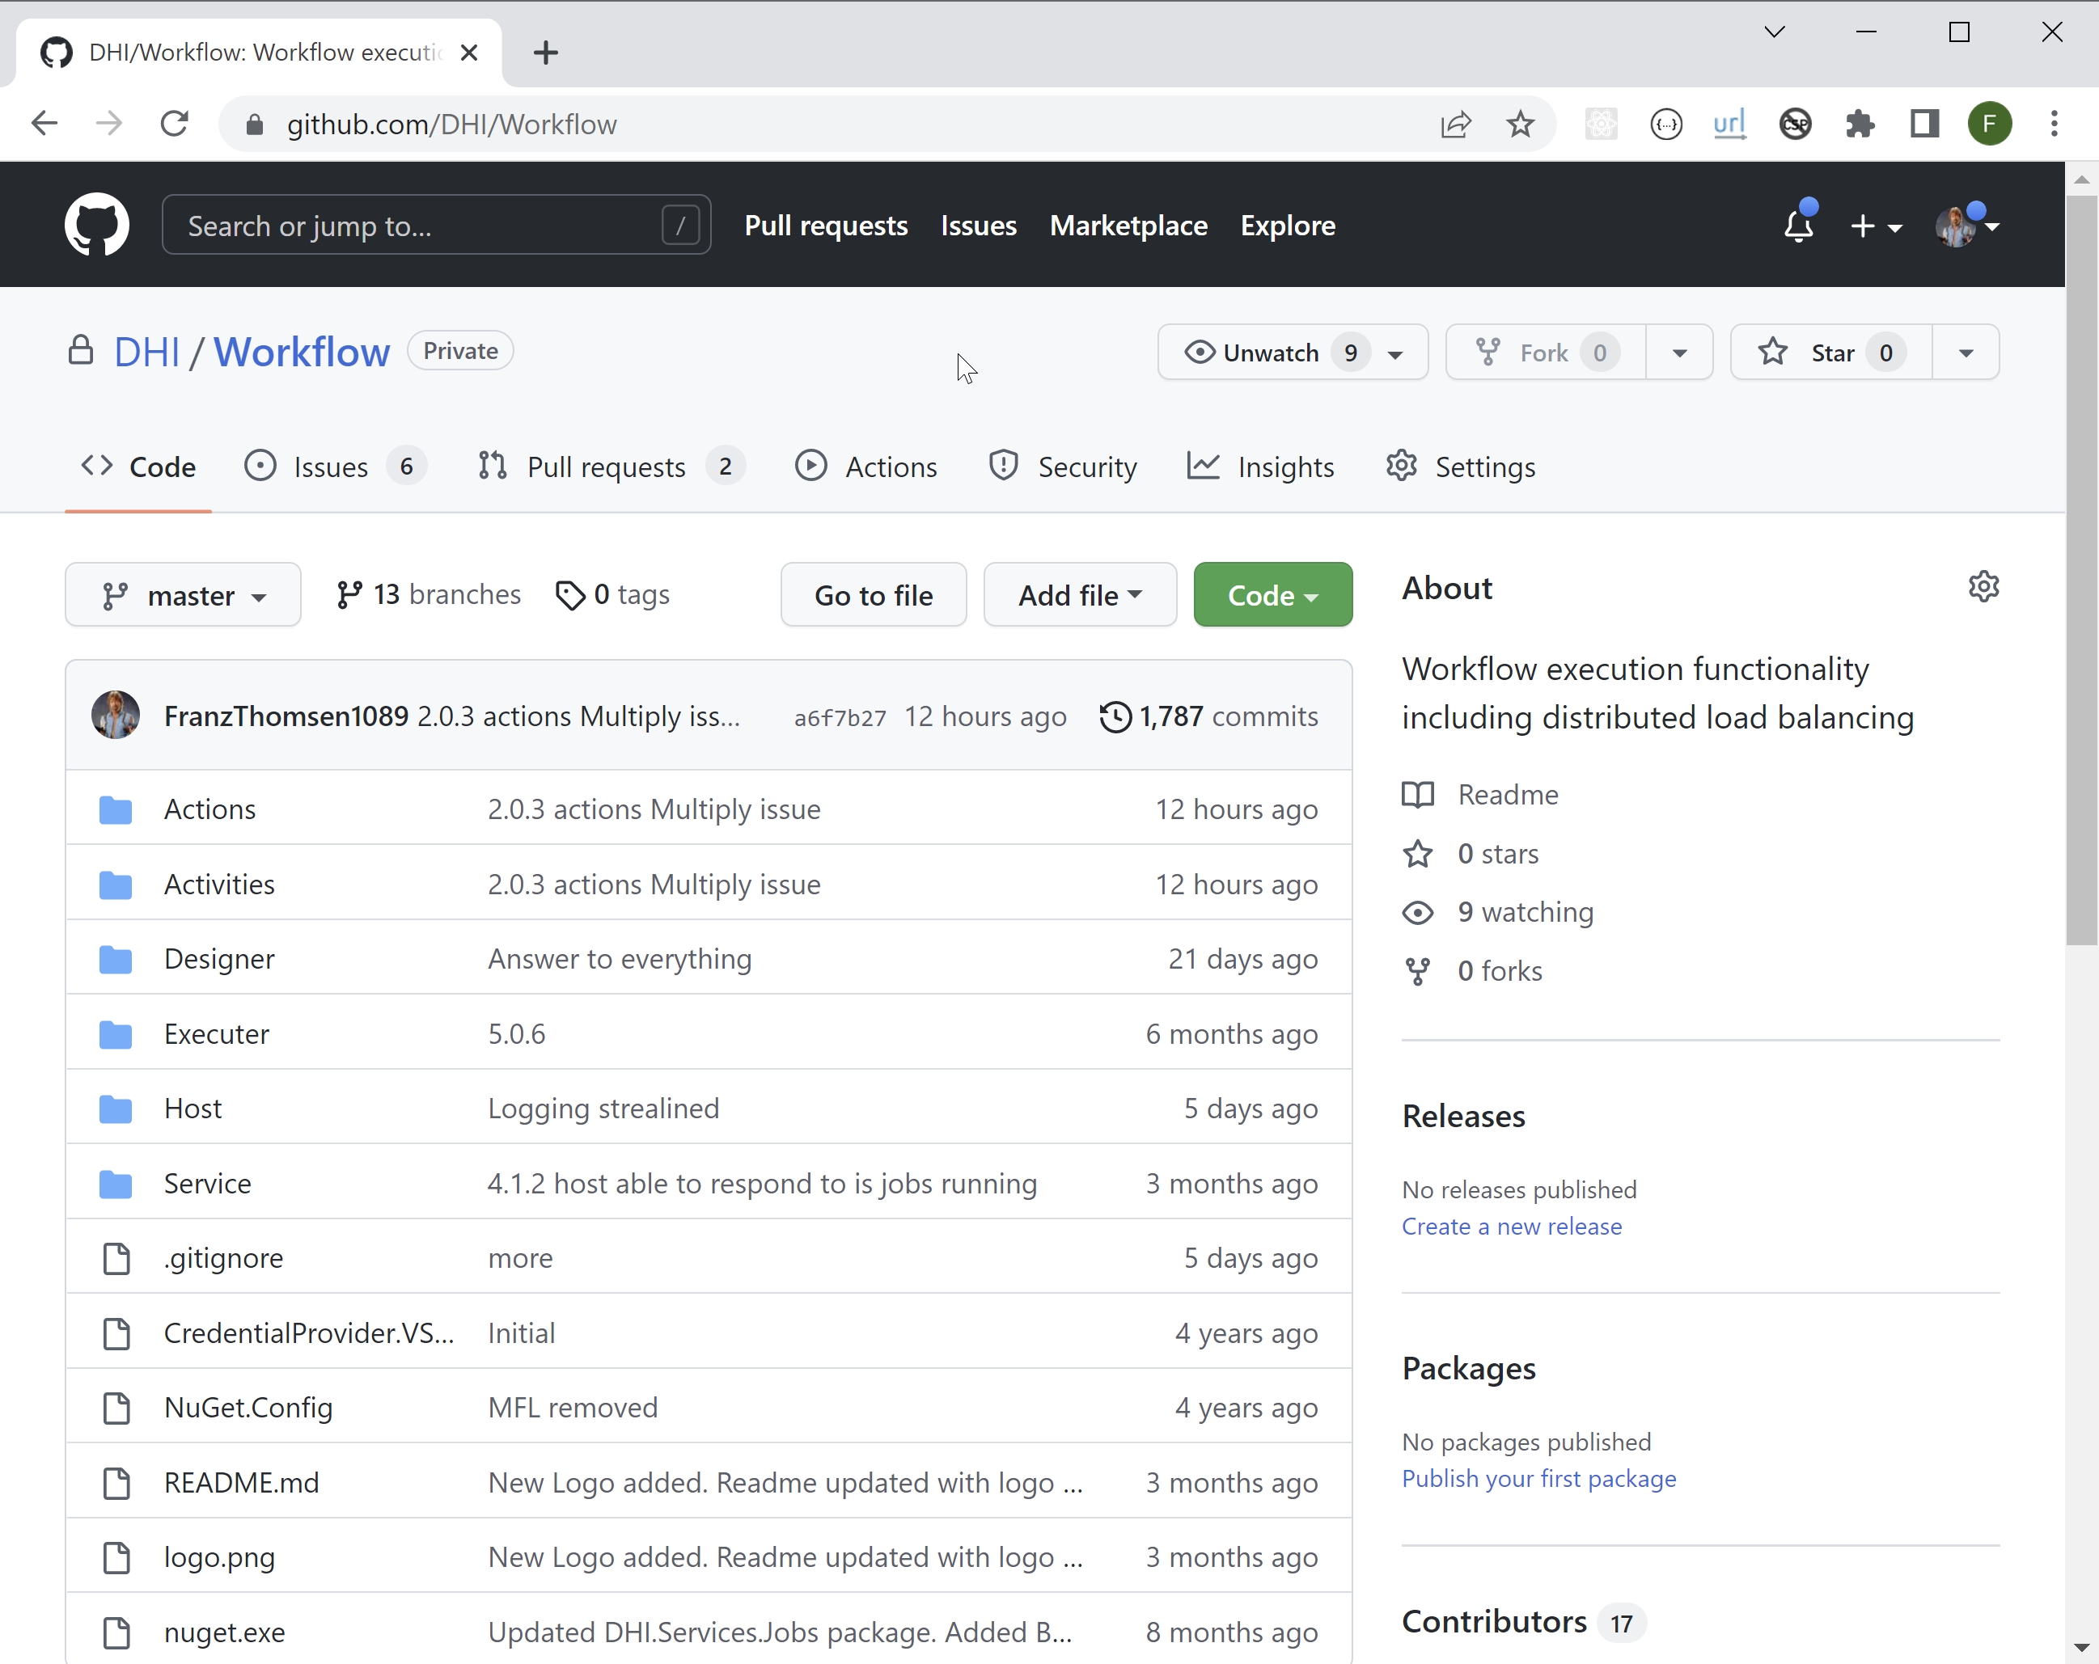
Resources
Developer Documentation
For packages, NuGet
For source, GitHub
Notes:
<use this slide for agenda>

Slide 9
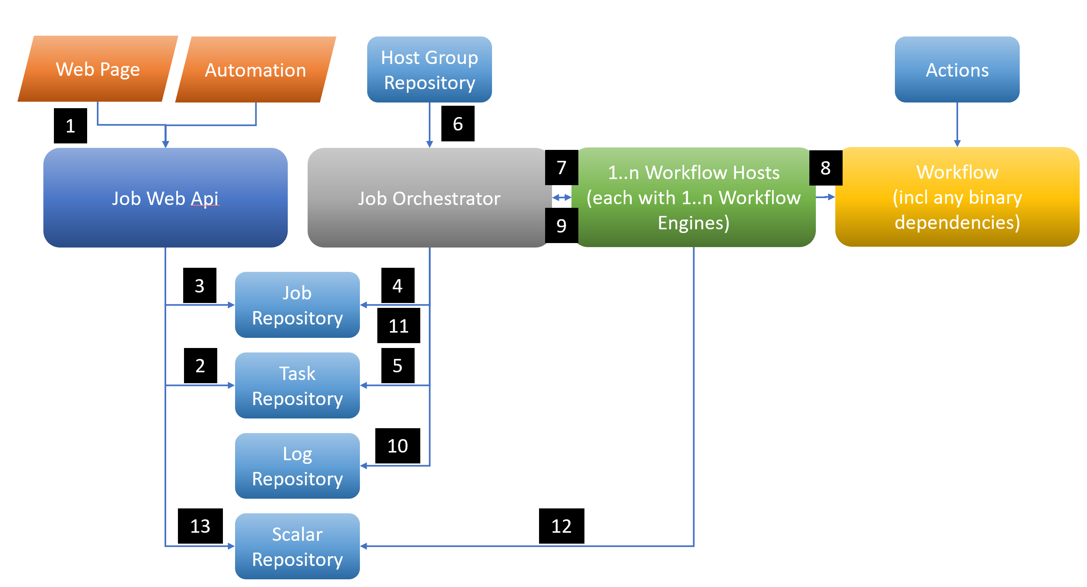
Architecture
Notes:
<use this slide for agenda>

Slide 10
Architecture
Job Repository: Where jobs are tracked with status, completion times etc
Task Repository: The workflows or a representation of these
Log Repository: Where logs go through
Host Group Repository: Registry of hosts to use VMs, ScaleSets, containers
Scalar Repository: A collection of individual values like health flags, other KPIs
Job Orchestrator: The mechanism delegating jobs to execute workflows to available hosts
Workflow Host: The mechanism on the VM, ScaleSets, container that execute the workflow
Workflow: The C# workflow that YOU build
Actions: The prefabs that you can base the Workflow on
Notes:
<use this slide for agenda>

Slide 11
Architecture
Notes:
<use this slide for agenda>

Slide 12
What do I have running for the Demo
Authorisation Server – Local postgres database
WebApis – Local postgres database
JobOrchestratorWinService … Lets see it
WorkflowHostWinService … Lets see it
Notes:
Job Orchestrator code
Choices made
Workers, example from NCOS

Slide 13
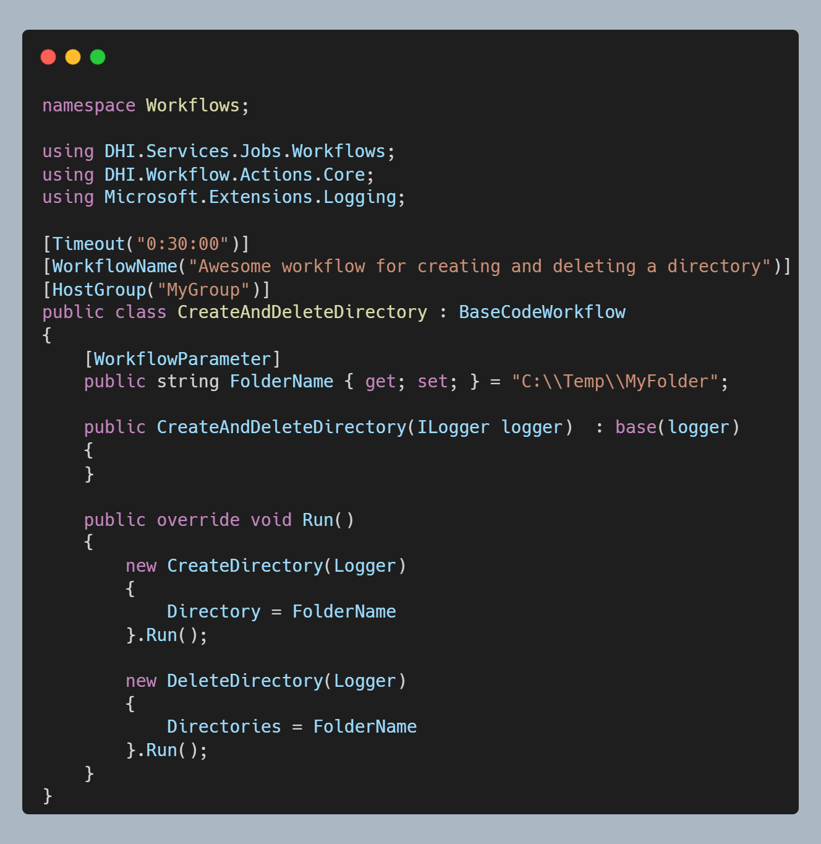
Anatomy of a workflow
Directory.Delete !!! … why Actions???
Comprehensive logging, concurrency management and retry policies needed for operational systems
Workflow timeout, how long is it allowed to run for
Workflow name, for display purpose only so far
HostGroup that the workflow should be executed through *
Parameter exposed e.g. through the web api
Main method called to run workflow
Microsoft ILogger injected
Use of Actions and other wonderful things
Notes:
Job Orchestrator code
Choices made
Workers, example from NCOS

Slide 14
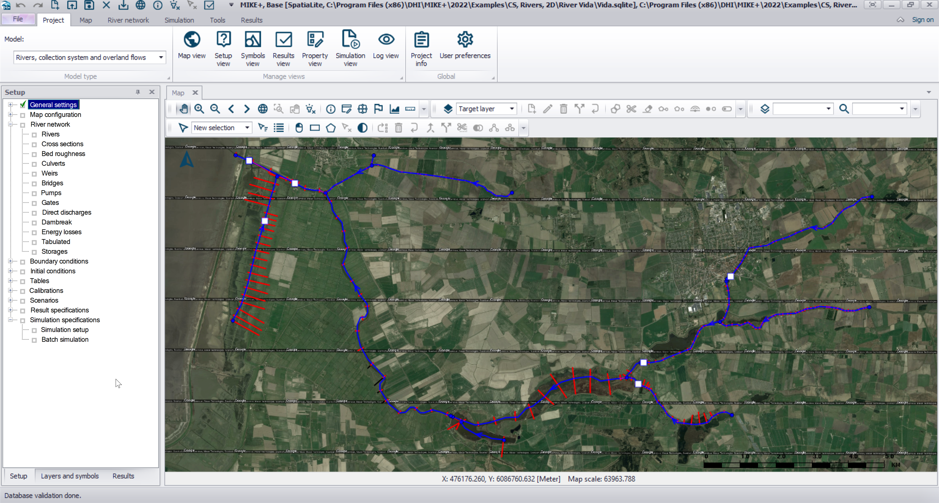
What do I want to Demo
Run MIKE1D river model in forecast mode
Scale input boundary
Extract result
For the sake of demonstration this example will include aspects that will occur in a forecast system and a scenario system, but probably not in both.
Notes:
<use this slide for agenda>

Slide 15
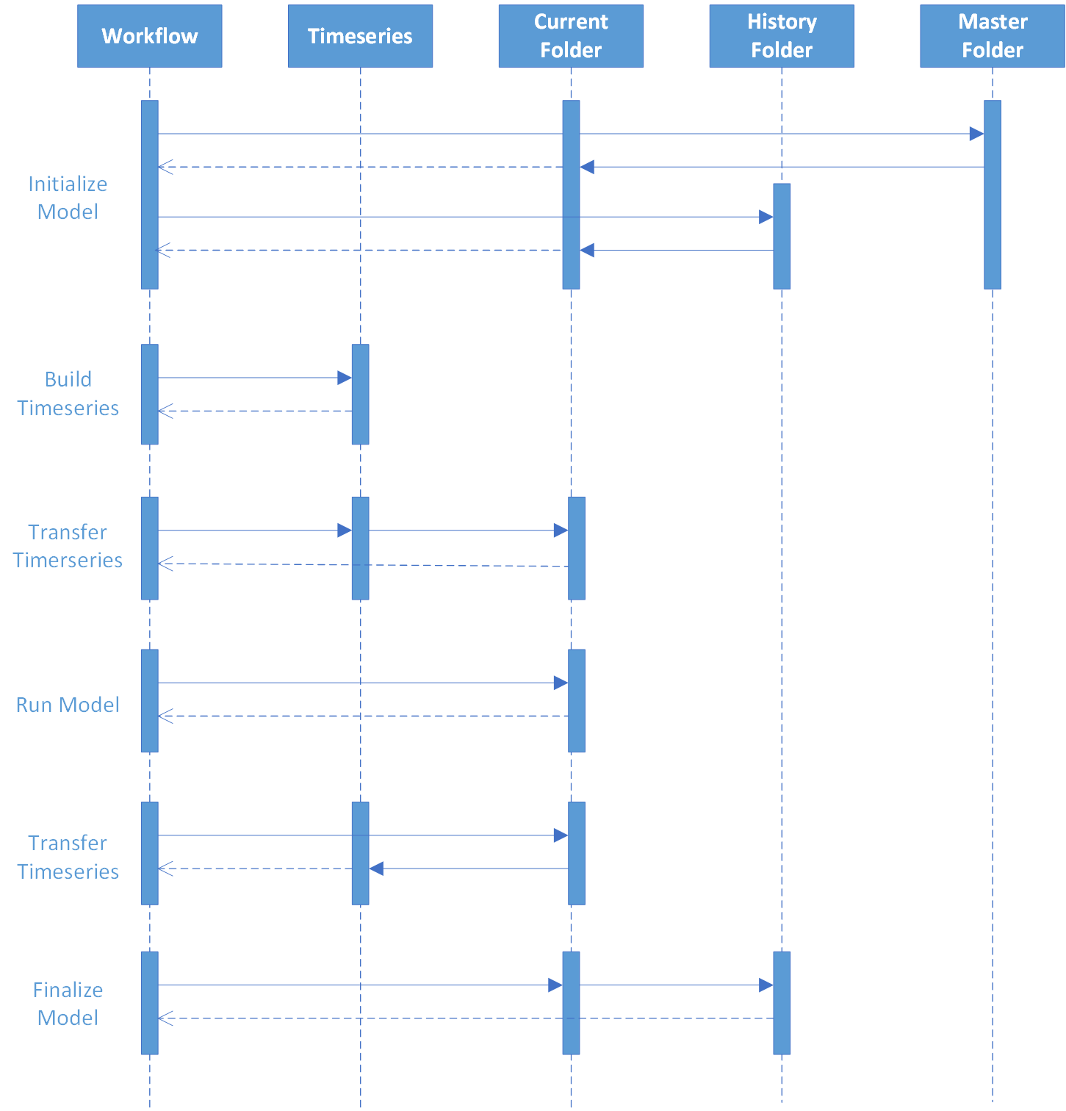
Actions in model execution for this Demo
Current Folder is where the model execution is being performed
History Folder is where previous runs are being archived
Master Folder is where the template model is stored
Documentation

Slide 16
Time series actions - BuildTimeseries
BuildTimeseries
Based on spreadsheet configuration (xlsx/MO/md) where each row defined a time series to be constructed
A time series is constructed based on multiple time series being subjected to multiple methods
A method working on a time series can simple like Offset, Delete, Resample etc to more complex like EstimateWindPeakGust etc
Documentation
For this example … Lets see it
Other use cases … Lets see it

Slide 17
Time series actions - TransferTimeseries
TransferTimeseries
Based on spreadsheet configuration (xlsx/MO/md) where each row defined a time series to transferred from one repo to another
Documentation and Documentation
For this example … Lets see it
Other use cases … Lets see it

Slide 18
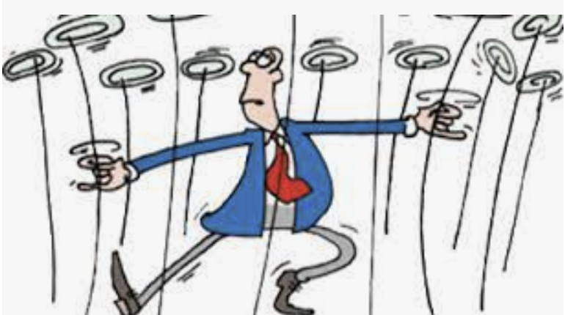
Lets see it run
From unit test
From webapi

Slide 19
Provider Cheat Sheet

Slide 20
Going forward
New designer?
Hybrid Execution option, Azure <-> On Prem/Data Centre
Workflow Host integration with Azure Artefacts
Kubernetes integration
Job Automater, scheduling and event based start of jobs
Notes:
<use this slide for agenda>

Slide 21

Notes:
<use this slide for breaks>

